Slide 1
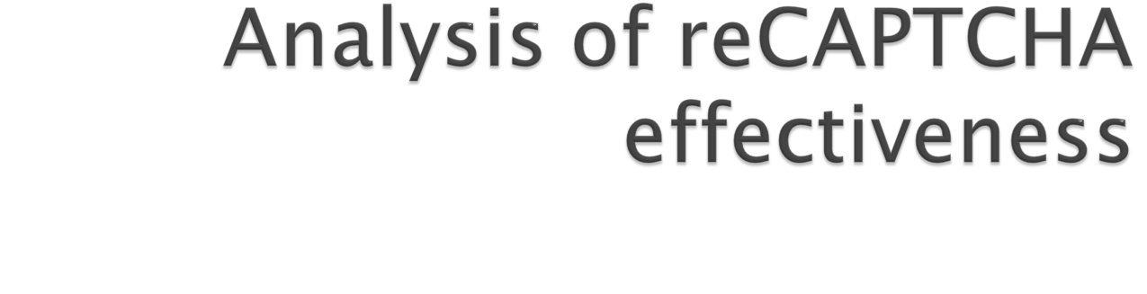
Dec 2, 2010
Rodney Beede
University of Colorado
CSCI 5722 – Computer Vision
@rodneybeede.com

Slide 2

Completely
Automated
Public
Turing test to tell
Computers and
Humans
Apart

Slide 3

SPAM prevention
  E-mail account signup
  Message forums
Verifying online polls
Stopping ticket scalpers
Thwarting botnets

Slide 4

Prevent automated means by OCR
  Challenge user to prove human
  Show characters or words in image
Distortion of image
  Random background noise
  Lines through image
  Bending or curving of image
Goal: Opposite of computer vision

Slide 5

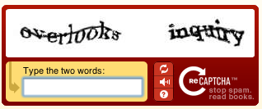
Invented in 2007 by Luis von Ahn
Acquired by Google in 2009
Methodology
  Two distorted words presented
  Control word with known solution
  Unknown word
    Historical text
    Undistorted hard for OCR

Slide 6
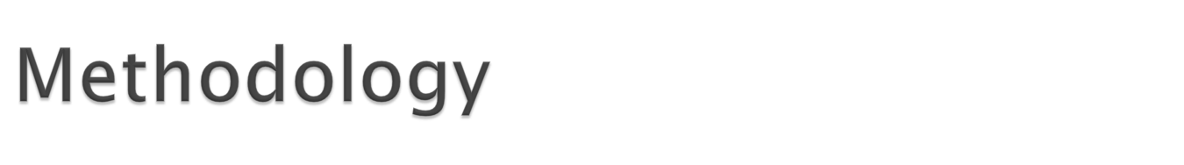
Collect 1,000 sample reCAPTCHA’s
Hand enter correct solution
Analyze with regular OCR
Analyze with anti-recaptcha
Compare percentages

Slide 7
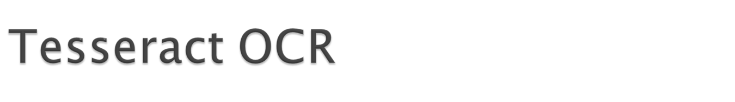
Developed by Hewlett Packard in 1985
Open sourced 2005
Maintained by Google now
Uses adaptive thresholding
  Separate background & foreground
  Outlines of characters with polygonals
  Trained with dictionary

Slide 8

Invented October 2010 by Benjamin Wegener
Pre-processing algorithms in PHP
  Take reCAPTCHA image
  Undistort it
  Hand new image to Tesseract OCR
Purpose of creation
  Defeat CAPTCHA on software download sites

Slide 9

Find left edge of first word
Find right edge of first word
Repeat for second word
  Threshold of white columns to separate words
Map the top and bottoms of each character column based on a threshold
For each column look for pixels that exceed a certain red threshold

Slide 10
If threshold met set to white
  Otherwise black
Count the number of black & white pixels
This creates a 1.5 ratio contrast
“By using different intensities of contrast for each word, two problems are dealt with at once: the distinction between normal fonts and bold ones and the removal of “dirty spots” or artifacts left over by OCR. Hereby the density of black and white pixels in the areas of both words is separately adjusted to a ratio of 1.5 white to black pixel” (Wegener)

Slide 11
Magnify the contrast image with h2qx
  Uses a pixel art algorithm for anti-aliasing
  Larger image allows sharpening with less risk of detail loss inside characters
Sharpen the image
Calculate top and bottom of each character column
Calculate middle black pixel in each column

Slide 12
Move columns by
(height of image / 2) - center value(x)
  Center value is smoothed by 0.2 to reduce bumps in transitions
Crop top and bottom whitespace from image
Hand image to OCR

Slide 13


Original reCAPTCHA
  (enlarged for presentation)

Slide 14
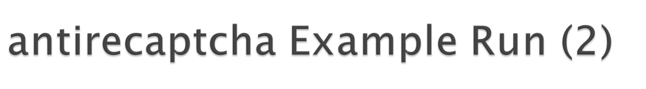
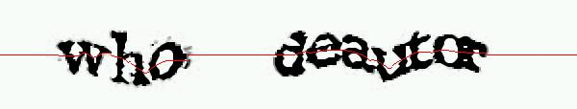
During processing
  curvature line imposed in red for debug purposes

Slide 15

After processing

Slide 16

 | Regular OCR (Tesseract) | antirecatpcha
Complete Match | 0.2% | 2%
Partial Match | 10.7% | 21.6%
No Match | 89.1% | 77.4%
Table 1: Out of 1,000 samples. Complete means both words matched Partial means only one word No means neither word.

